Slide 1
Catastic Companions
Presented by: Arica Conrad
BIT 465 – REST API Development
March 16, 2022

Slide 2
What is My API?
My API is for a fictional cat shelter called Catastic Companions. Catastic Companions keeps track of all the cats they have housed at their shelter, including the ones who have now been adopted.
I imagined that this API would used at the shelter for internal use only, so it is not public-facing. Therefore, the shelter employees must log in to view the list of all the cats.
An employee (user) can sign up, log in, and log out.
The head of the shelter (the superuser) can see all the employees (users) and the cats, but the rest of the shelter employees can only see the cats.
All employees can see all the cats and view the details of one cat. They can create, edit, and delete a cat.

Slide 3
API Screenshots

Slide 4
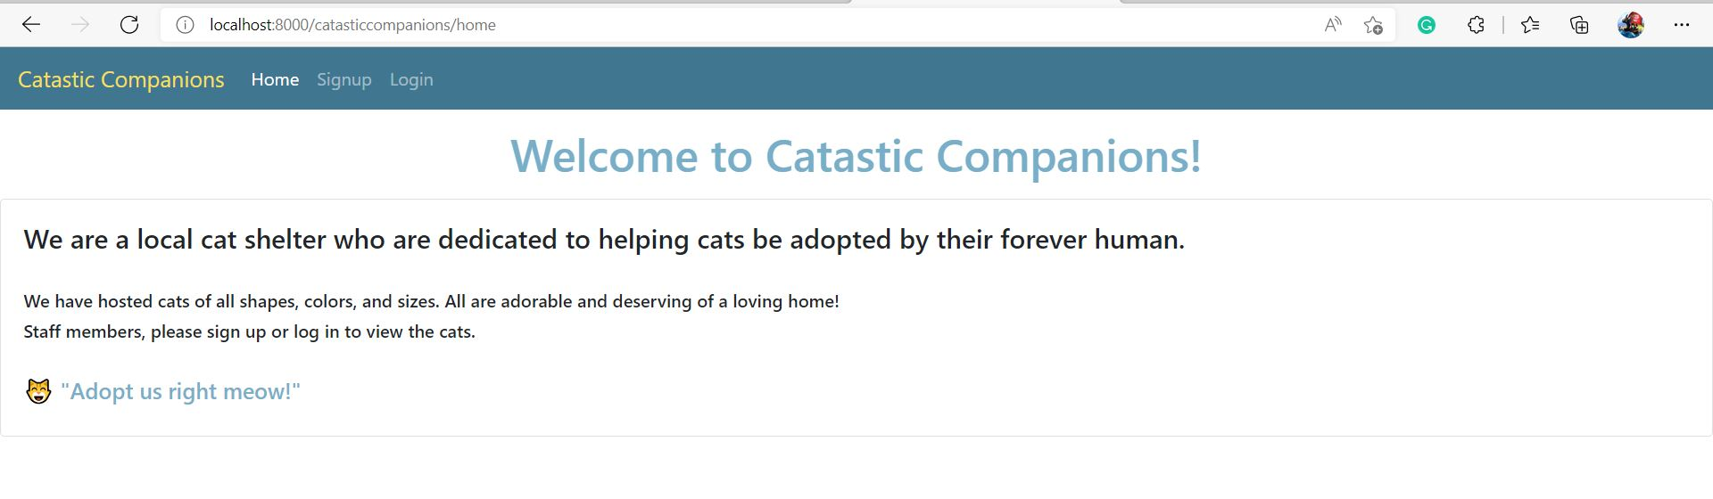
Home Screen (Not Logged In)

Slide 5
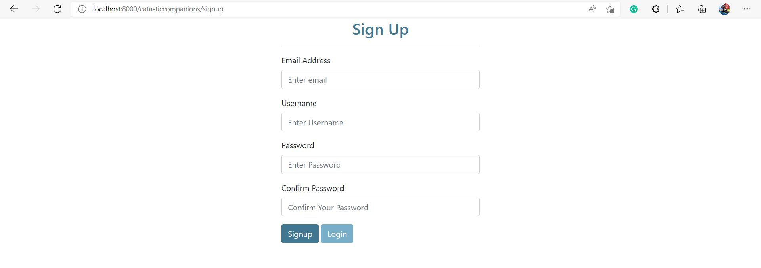
Sign Up Screen

Slide 6
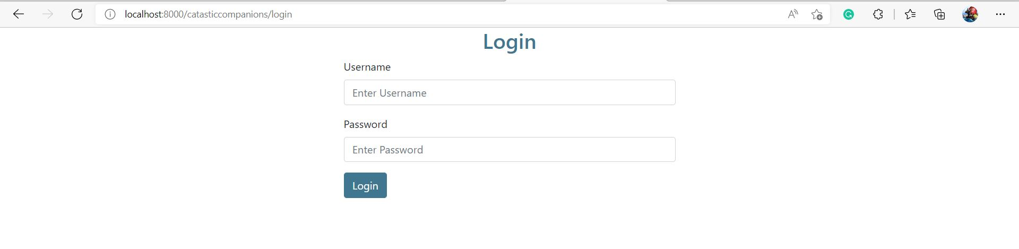
Login Screen

Slide 7
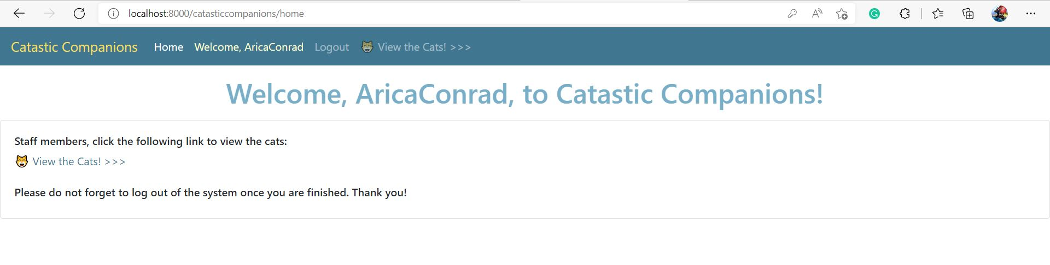
Home Screen (Logged In)

Slide 8
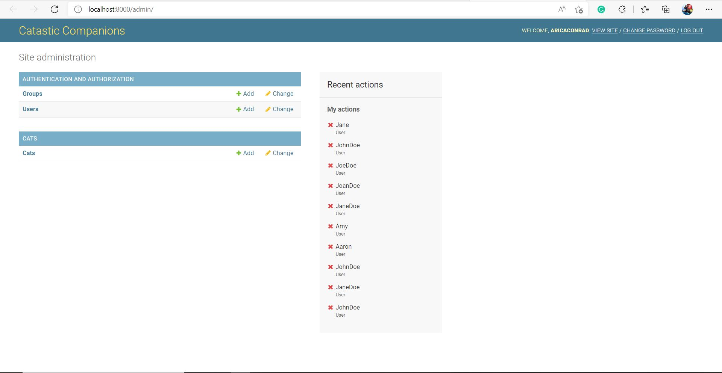
Django Admin Home Screen (as the superuser)

Slide 9
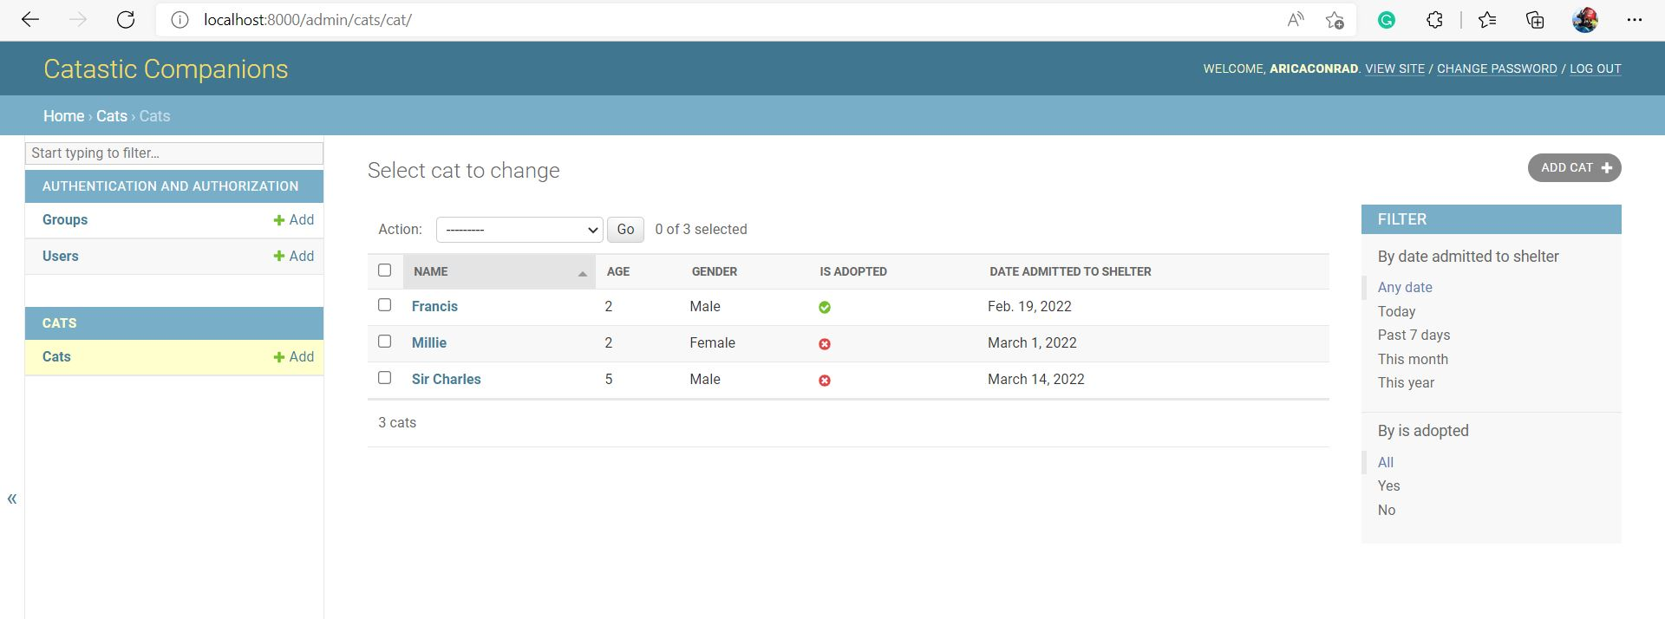
Cat List View (Django Admin)

Slide 10
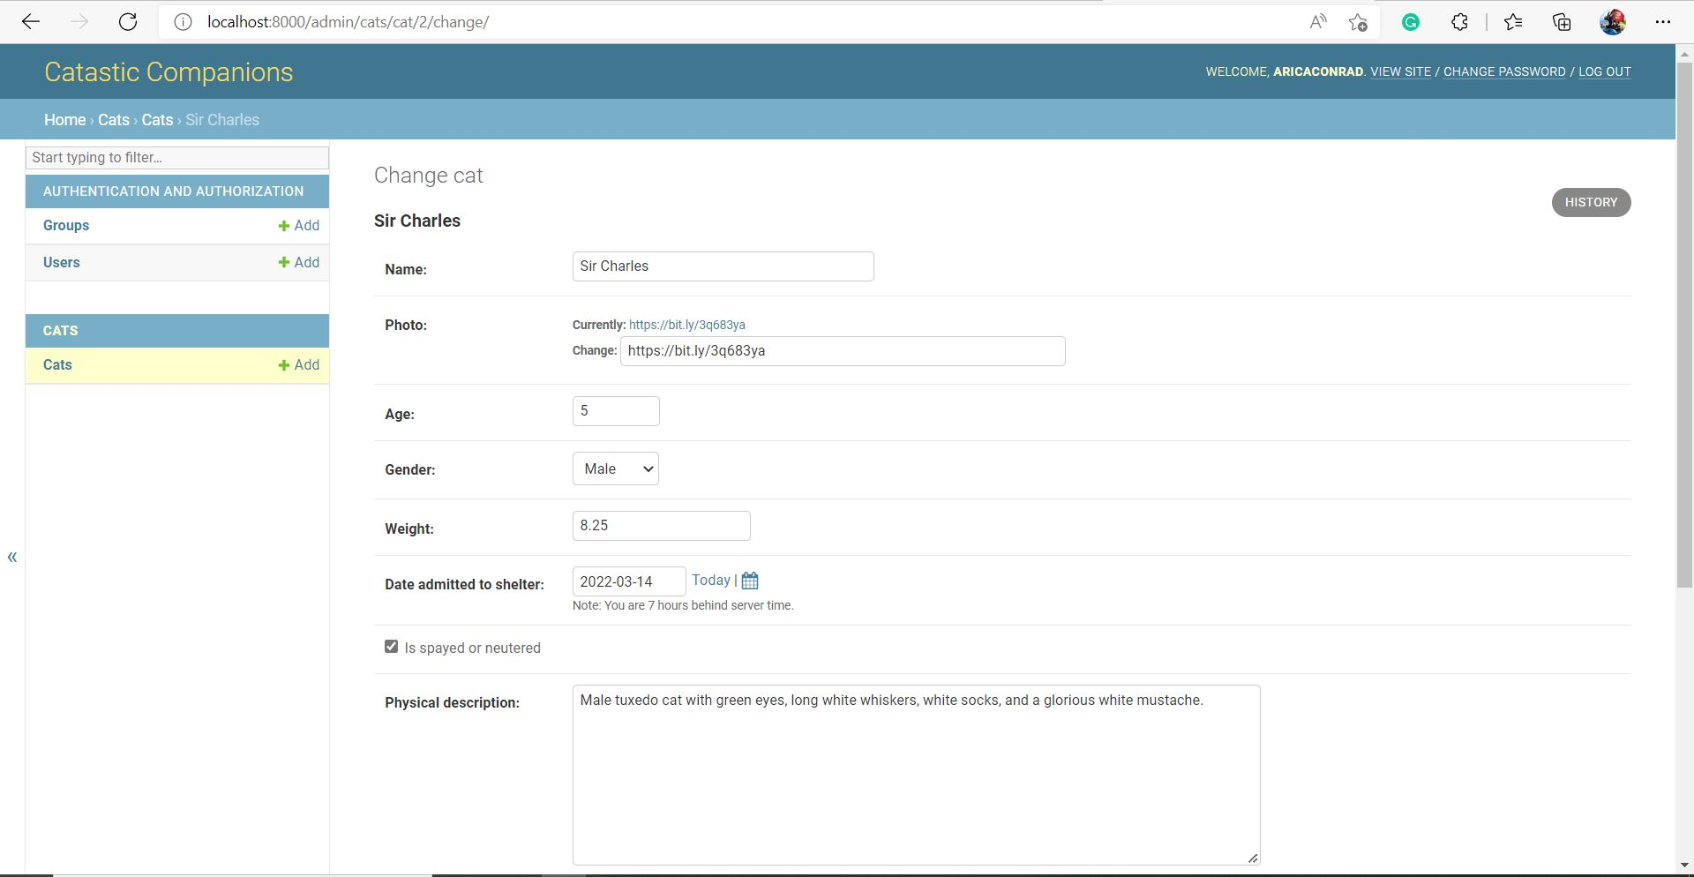
Cat Detail View (Django Admin)

Slide 11
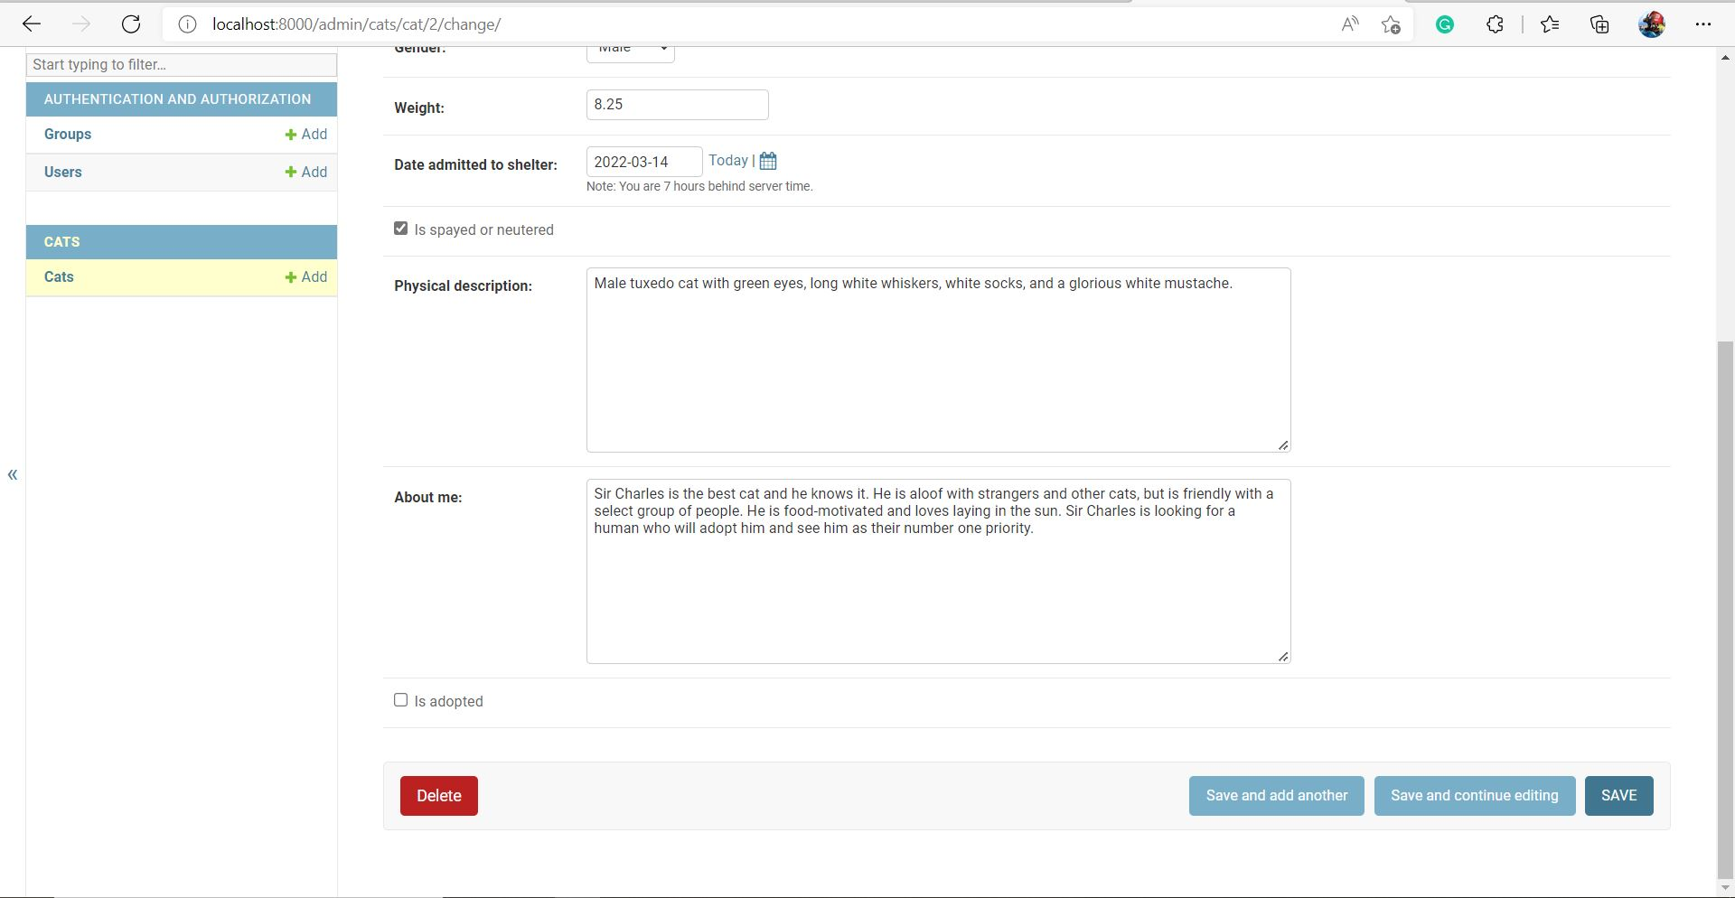
Cat Detail View (Django Admin) Continued

Slide 12
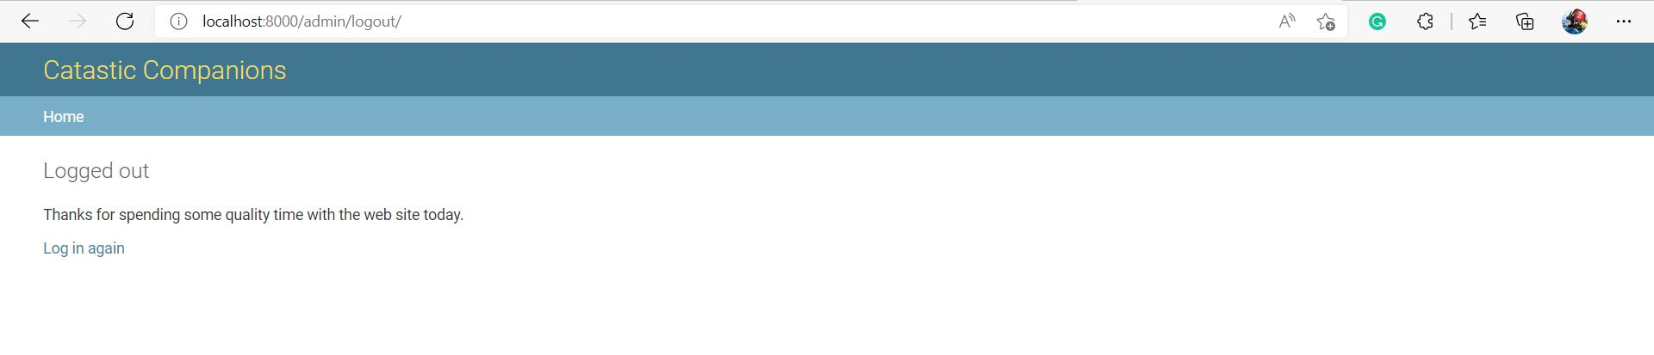
Logged Out (Django Admin)

Slide 13
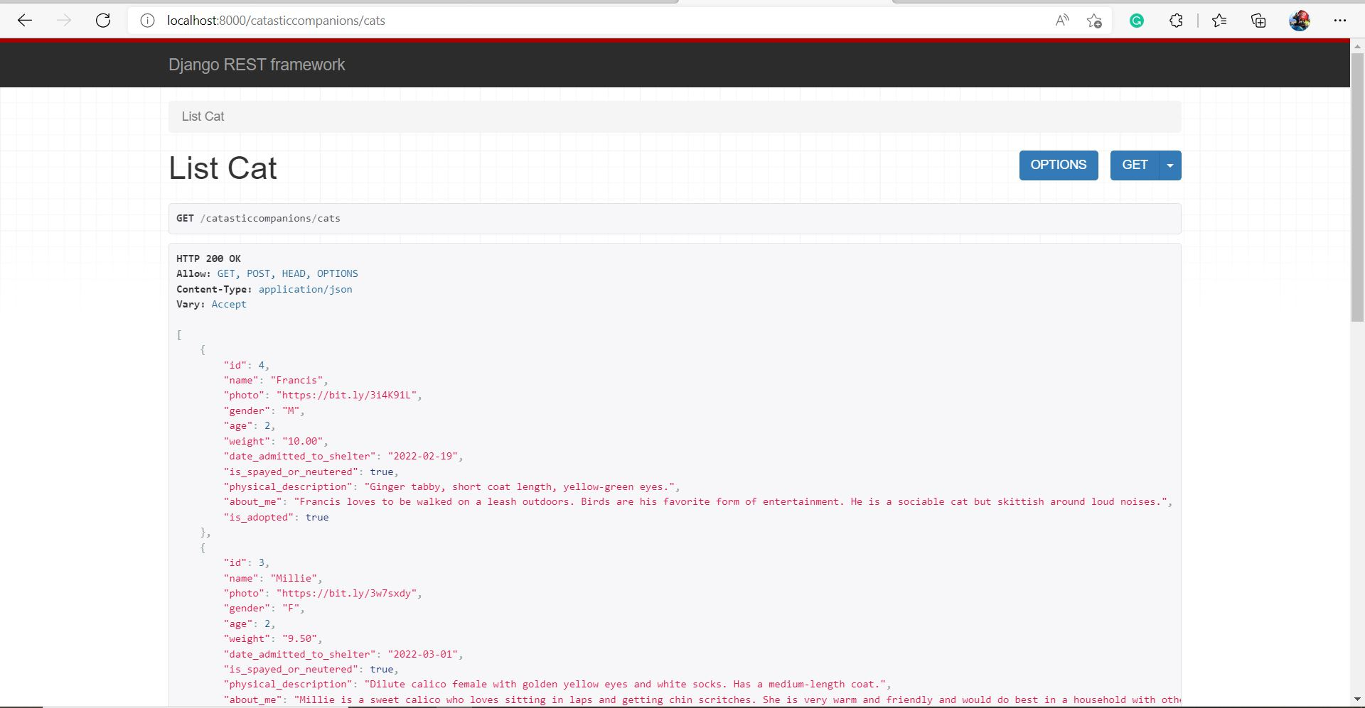
Cat List View (JSON)

Slide 14
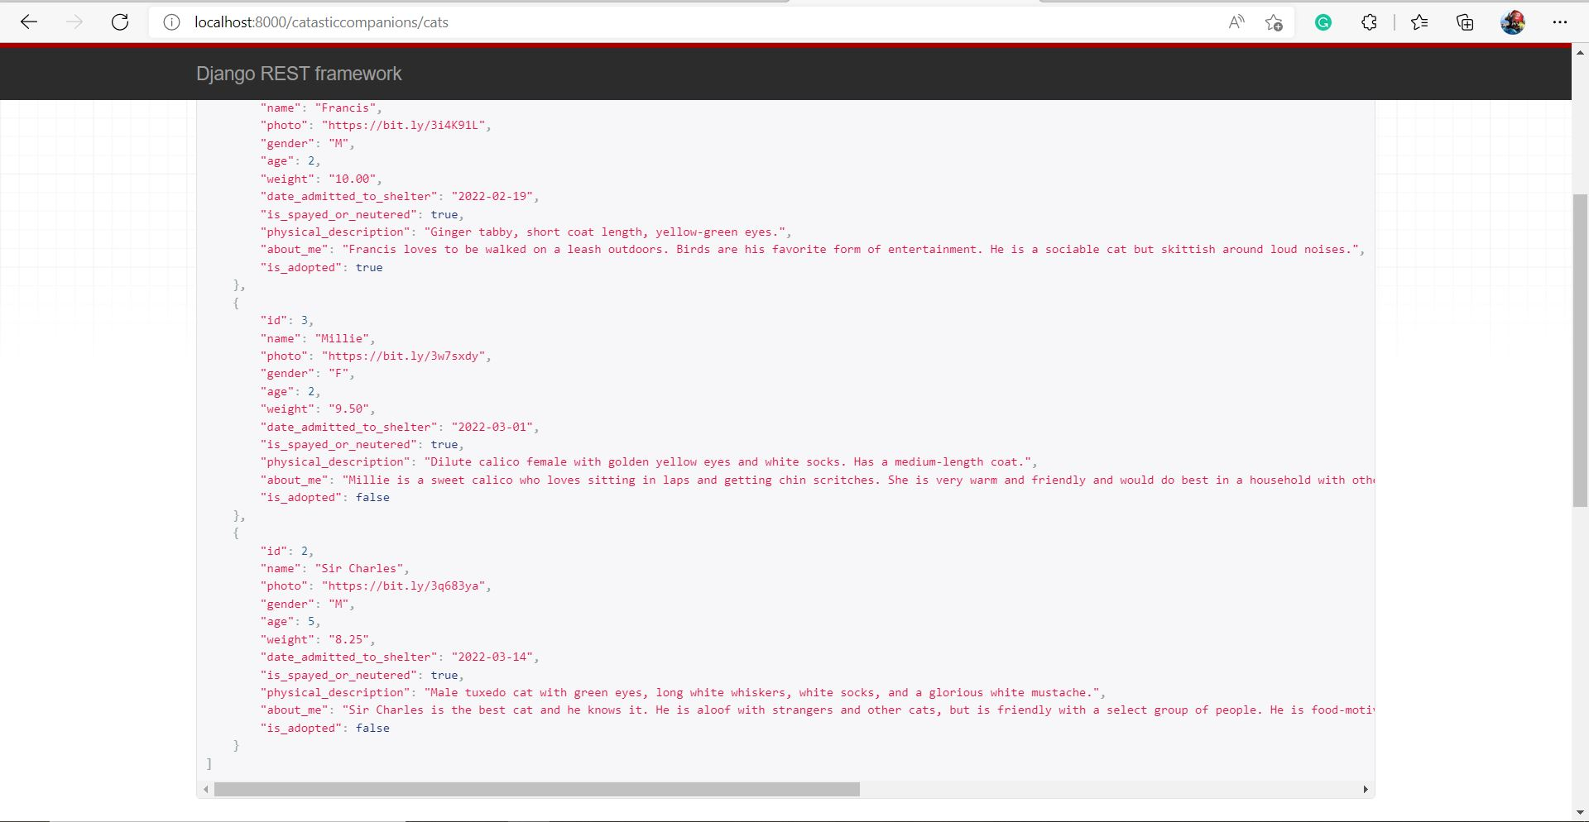
Cat List View (JSON) Continued

Slide 15
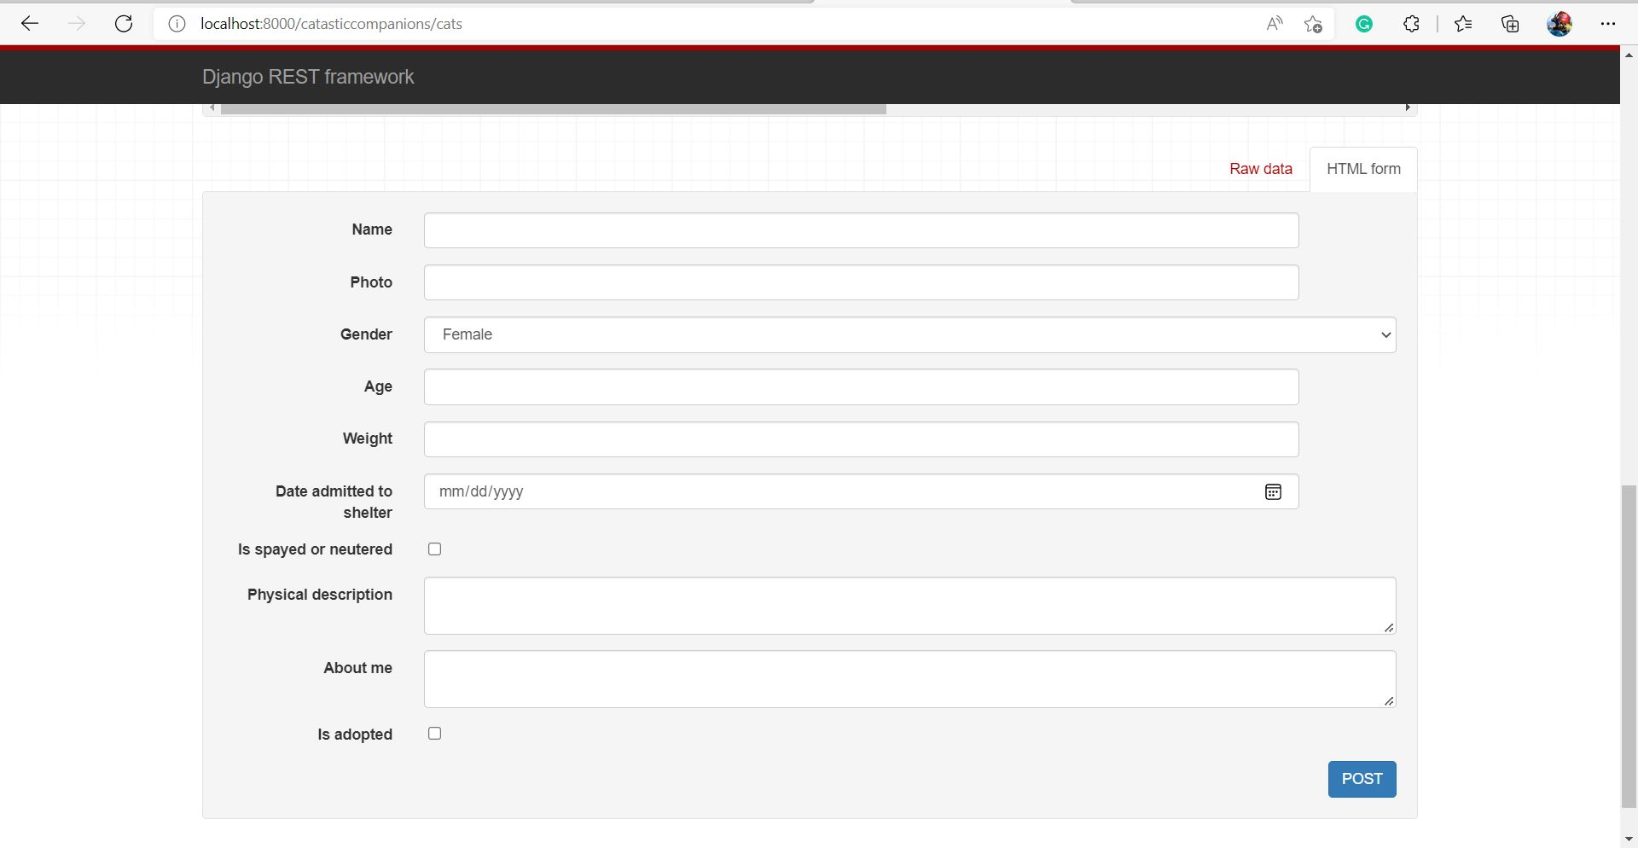
Cat List View (JSON) Continued

Slide 16
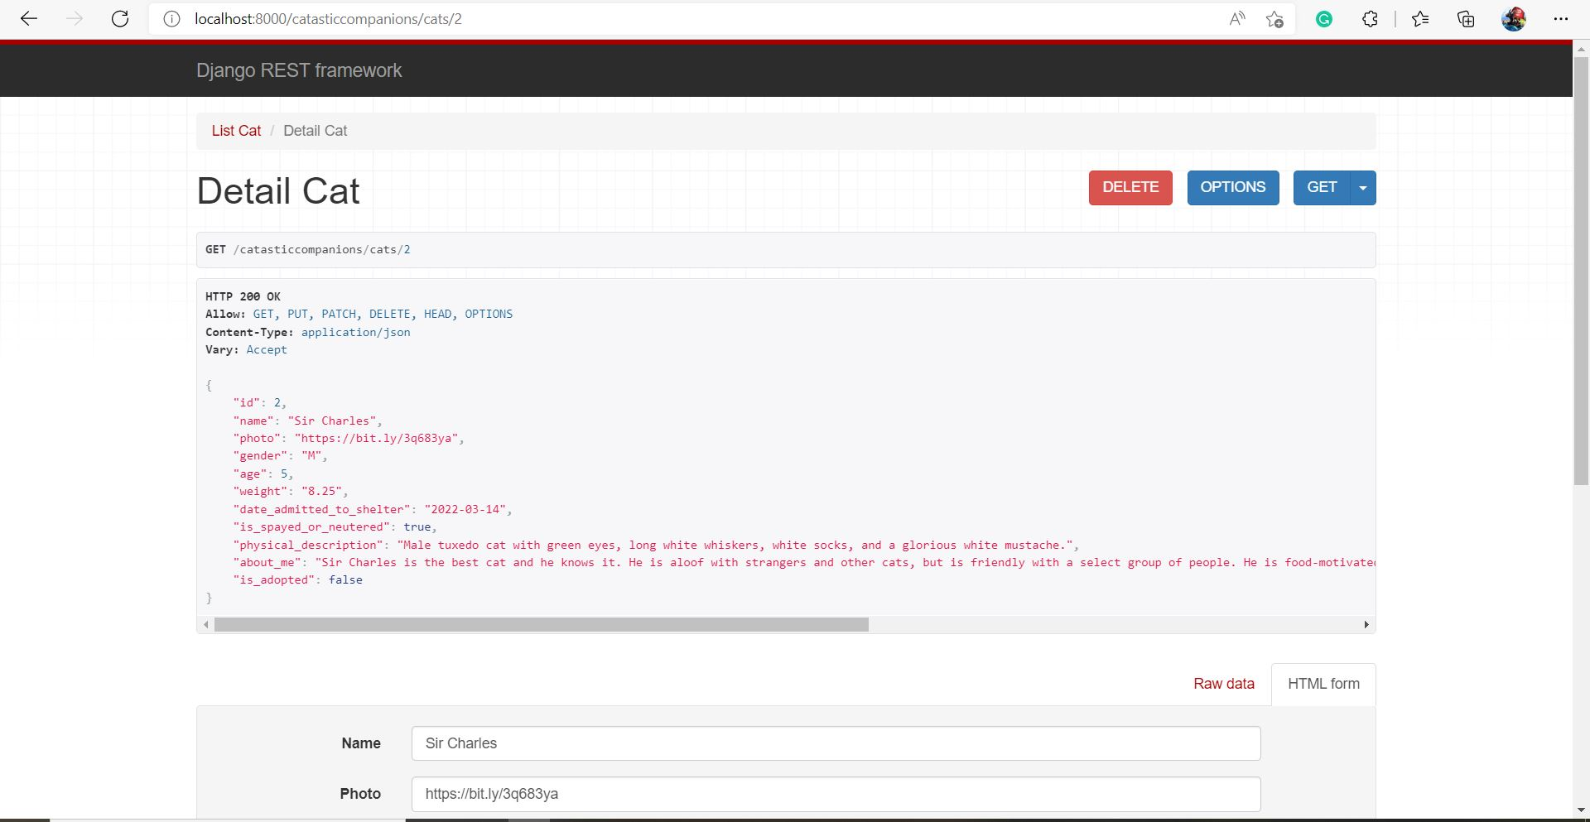
Cat Detail View (JSON)

Slide 17
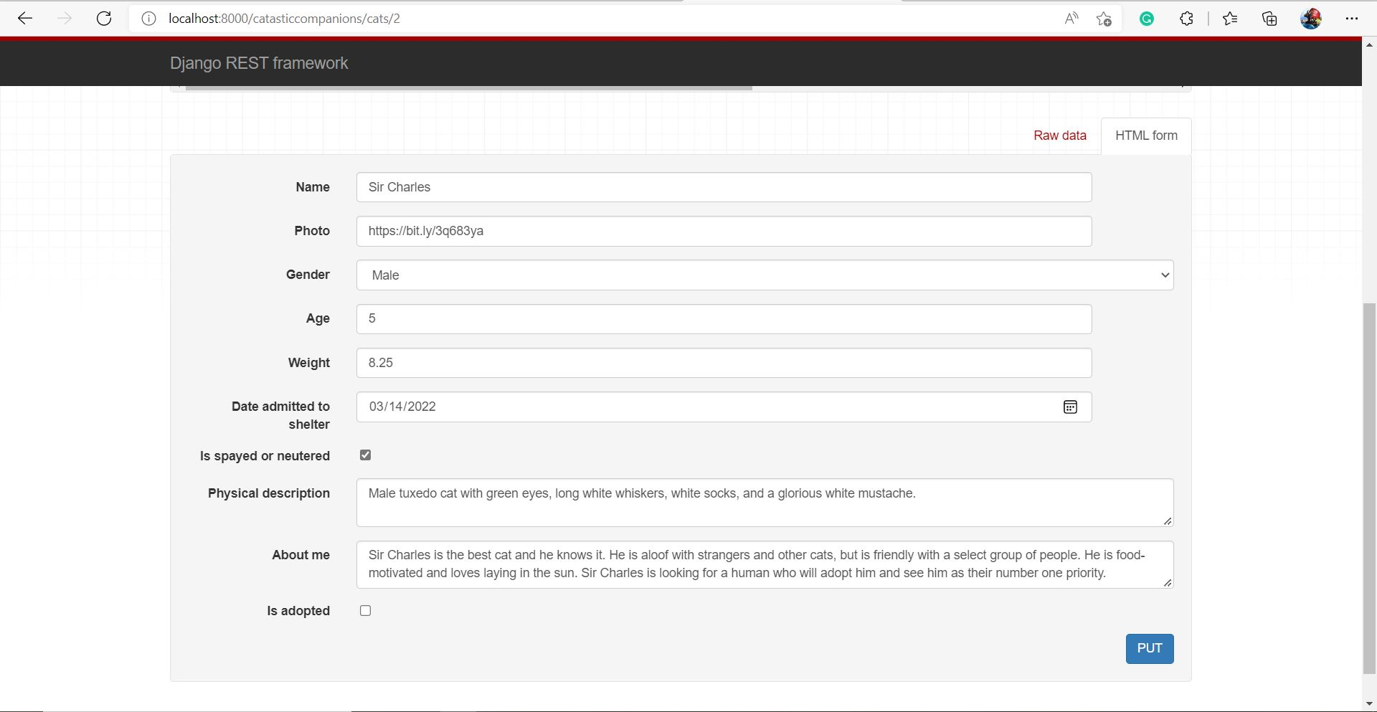
Cat Detail View (JSON) Continued

